Slide 1
Survival of the Opennest Microsoft’s Journey to Open Source
Martin Woodward
@martinwoodward
Sasha Rosenbaum
@DivineOps
Notes:
Martin – then Sasha

Slide 2


Notes:
But to begin, I need to go back before the Microsoft you know today

Slide 3

Notes:
In fact back before graphics were a thing

Slide 4

“There is this thing called the GPL, which we disagree with
.“
- Bill Gates
Notes:
He dislikes Open Source software because the license says that “nobody can improve it. ever.”

Slide 5

“Linux is a Cancer.”
- Steve Ballmer

Slide 6

“Microsoft was on the wrong side of history.”
- Brad Smith
Notes:
[Martin]
Brad Smith has been at Microsoft for more than 25 years and was one of the company’s senior lawyers during its battles with open-source software.
“Microsoft was on the wrong side of history when open source exploded at the beginning of the century, and I can say that about me personally.”
“The good news is that, if life is long enough, you can learn … that you need to change”

Slide 7
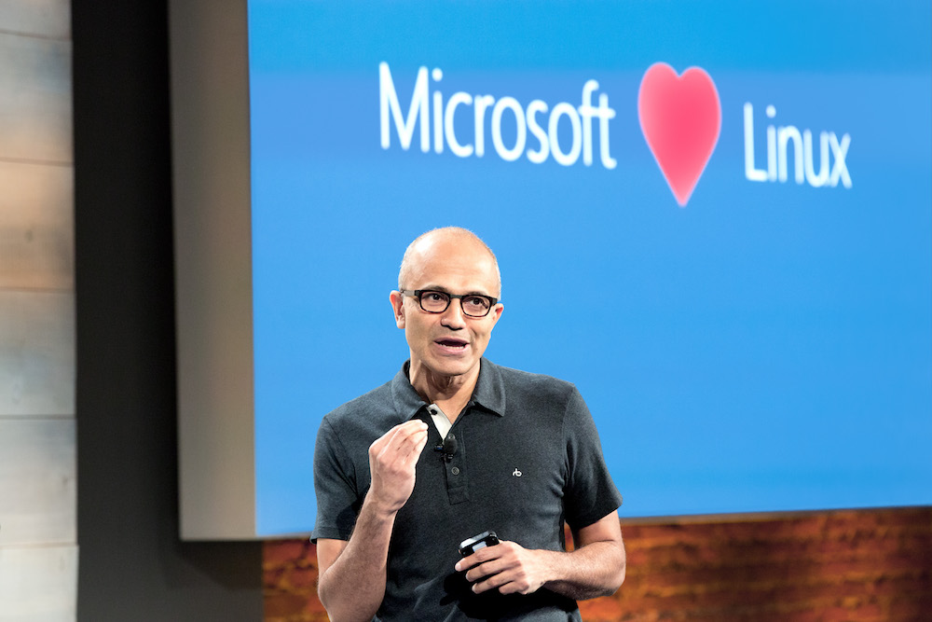
Notes:
In contrast, our new CEO, Satya Nadella, is willing to stand in front of a giant display that says that Microsoft loves Linux.

Slide 8

Microsoft Open Source
2019
~25k Microsoft employees committing to open source projects on GitHub
>8.8k open source projects in Microsoft organizations
Edge moved to Chromium
Windows Terminal
GitHub Sponsors (with matching)
2018
Visual Studio Code ranked #1 developer tool
FHIR Server for Azure Released
Azure Sphere with Linux kernel
GitHub acquisition
~5,000 Microsoft employees committing to open source projects on GitHub
Azure trending to 50% Linux
2017
Microsoft Azure Kubernetes Service launched
Draft, Brigade, Kashti projects submitted to Kubernetes community
Microsoft joins Cloud Native Computing & Cloud Foundry Foundations
SQL 2017 on Linux
Windows source code moved to Git
2016
.NET Core 1.0
PowerShell Core
Windows Subsystem for Linux in Windows 10
Microsoft joins Linux Foundation
GitHub recognizes Microsoft as a top open source contributor
2015
Visual Studio Code released
HDInsight (Hadoop/ Ubuntu) announced
Microsoft jointly forms Node.js foundation
2014
Satya “Microsoft loves Linux”
Microsoft org on GitHub created
.NET Foundation created
2014
2015
2016
2017
2018
2019
Notes:
& at Microsoft we love open source.
First OSS project was in 2004 when the Windows Installer Toolkit (WiX) was released to SourceForge.
Started contributing to the Linux kernel in 2009
I joined Nov 2009 – contributed 18 byte fix to Eclipse, super painful.
Every year we do more & more in the open source realm.
How we embrace the projects the community has embraced… from Linux to Kubernetes.
One of the ones I was deeply involved in was whether to compete with Git or become part of it. Today most of MS development is done in Git. The source control system that Linux created.
Including Windows. Think about that for a second, the Windows team use the source control system written by Linus Torvalds.
Or the ways we increasingly open source the software we work on… from .NET to VS Code & TypeScript. In fact, much of the core tech in Azure Pipelines itself is open source

Slide 9
Microsoft’s Open Source Journey
7 Steps to becoming an Open Source Enterprise

Slide 10
Step One: Consume Responsibly
Notes:
Sasha

Slide 11
Don’t be a jerk
Open source maintainers don’t owe you anything

Slide 12




GitHub Sponsors Directly help fund the success of the projects in your supply chain
Notes:
GitHub will not charge fees for GitHub Sponsors.

Slide 13
Do you use open source?

Slide 14


Open source software in the Enterprise
New Code
99%
of organizations make extensive use of open source
Inner Source
90%
of new application development leverages open source software.
Open Source
New Application Code
Source: Forrester Wave Software Composition Analysis 2017

Slide 15



Diagram

Slide 16
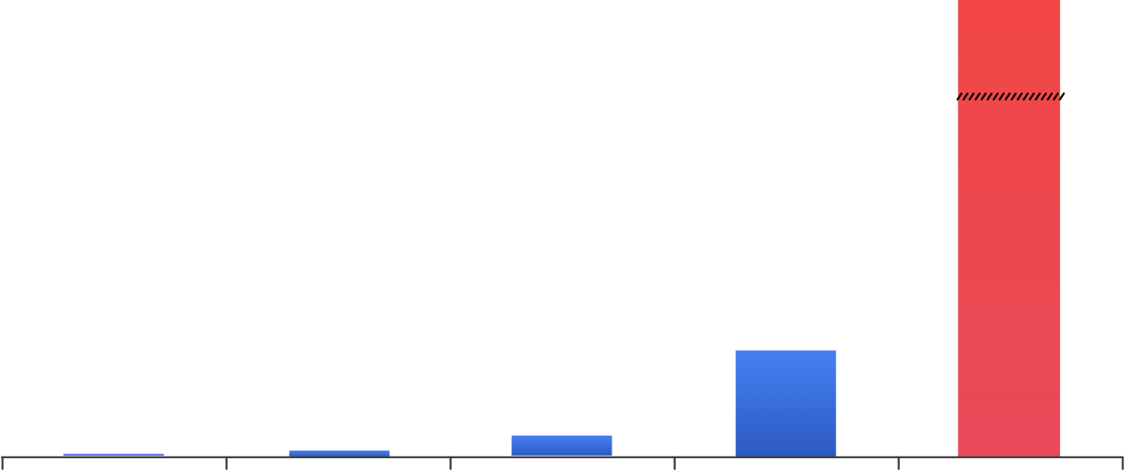
Shift left with security
$ Millions
$7,600
Remediation
costs
$80
$240
$960
SDLC
stages
Develop
Build
Test
Deploy
Breach
Notes:
And one thing everyone is doing now is to try to put developers more in control of security. But here’s a problem – developers aren’t security experts. And they don’t often follow the right security practices. And there are very few security researchers out there today – a lot of companies don’t even have any – and they don’t usually get along well with developers. So we need to make this better by baking security into developer workflows, and also finding ways help security researchers and developers collaborate better.

Slide 17



Secure your software development lifecycle
Supply Chain
Code scanning
Secret scanning

Slide 18

Step One: Consume Responsibly

Slide 19
Step Two: Understand the Business Need to Contribute
Notes:
Martin

Slide 20
Don’t Fork A fork is just integration debt
Notes:
If you fix bugs locally and do not push them upstream, you make it very hard to pull newer versions of that library down and you
In MSFT fixed policies so that anyone can push a simple big fix upstream to a project under a known set of licenses & get automated approval
Transition: Lets talk about the contribution funnel

Slide 21
Open source communities value code over everything else
Talk is cheap
Notes:
If you want to have influence in the direction of an open source project, you need to be an active contributor and be adding value to the community to have your voice heard.
Lets look at an example of a project that we wanted to take a critical dependency on and therefore wanted to be able to have some influce.

Slide 22


Contribution Funnel
CONSUME
Use, fork, follow, favorite
CONTRIBUTE CODE
Bug fixes, tests, new features
MAINTAIN
Influence project direction
Review code
Welcome new contributors
CONTRIBUTE TIME
Log bugs, add documentation

Slide 23
In the year 2012…
Team Foundation Server leads the Gartner “Magic Quadrant” report for ALM
Microsoft
Ability to execute
Completeness of vision
Notes:
Martin

Slide 24

“This is one of the innovator’s dilemmas: Blindly following the maxim that good managers should keep close to their customers can sometimes be a fatal mistake.”
- Clayton Christensen

Slide 25
Microsoft Options (2012):
Ignore Git & Mercurial
Create our own DVCS
Back Mercurial
Back Git
Notes:
Linux community was on Git

Slide 26

Git in Microsoft

Slide 27
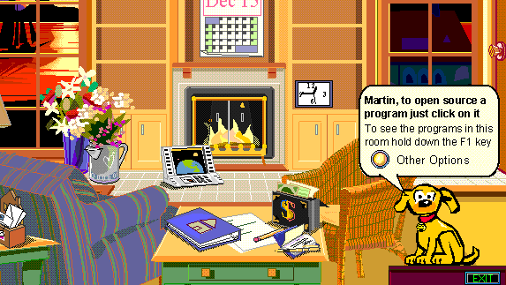

Slide 28
How OSS Contribution fits into Microsoft’s strategy
Collaboration
Distribution
Compatibility
Being agile in the open
.NET
TypeScript
Windows Console
Access a broad user base
VS Code
SDK’s
Docs
Work with existing OSS markets
Git
Linux
Kubernetes
Chromium

Slide 29
Dubious OSS “Business Goals”
Rarely good / sustainable reasons to open source a project or sacrifice IP - on their own.
Public Relations / Goodwill
Free work
Recruitment
Notes:
Sasha
Public Relations: A short-term PR hit will not have a lasting impact on the business's success
Goodwill: The ambiguous goal of "community goodwill" is neither measurable nor directly attributable to success
Recruitment: A popular project may attract attention and PRs from talented coders, but there are other ways to achieve this goal w/o sacrificing IP.

Slide 30

Step Two: Understand the Business Need to Contribute
Notes:
Sasha

Slide 31
Step Three: Convince your Stakeholders
Notes:
Sasha

Slide 32
Convince your Stakeholders
Team
Notes:
“But this needs to be secure, we can’t use open source!”
Are you not good at convincing people? Especially C-levels?
Do you have a sales person? Marketing?
Get _them_ on board. :D

Slide 33

Follow the money
Notes:
They talk to customers and they’ll challenge your assumptions
They are good at convincing people – it’s their job

Slide 34
Convince your Stakeholders
Team
Management
Notes:
Our management is used to hearing that we need things like fine-grained permissions and careful auditing. Git didn’t have that.
DISRUPTIVE TECH
Show them the numbers

Slide 35
Convince your Stakeholders
Team
Management
Senior Leadership

Slide 36


Slide 37
Step Three: Convince your Stakeholders
Notes:
Sasha

Slide 38
Step Four: Keep it Legal
Notes:
Martin

Slide 39
Keep it Legal
Understand the different types of Open Source licenses
Different licenses have different responsibilities
Ignorance is no excuse for non-compliance
Educate your legal team… and let them educate you
Understand your dependencies
But don’t be afraid of Open Source
Open Source contributors want you to use their software!

Slide 40
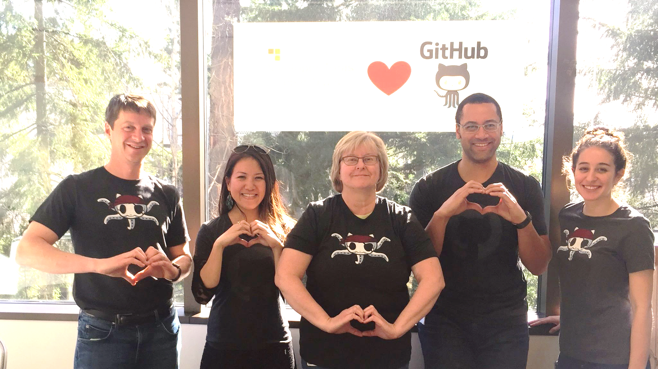
Notes:
You own the business strategy
You are responsible for shipping
Lawyers advise you so that you don’t
Take risks above your pay grade
Damage Microsoft
Do anything naughty

Slide 41
Step Four: Keep it Legal
Notes:
Martin

Slide 42
Step Five: Be the Community
Notes:
Sasha

Slide 43
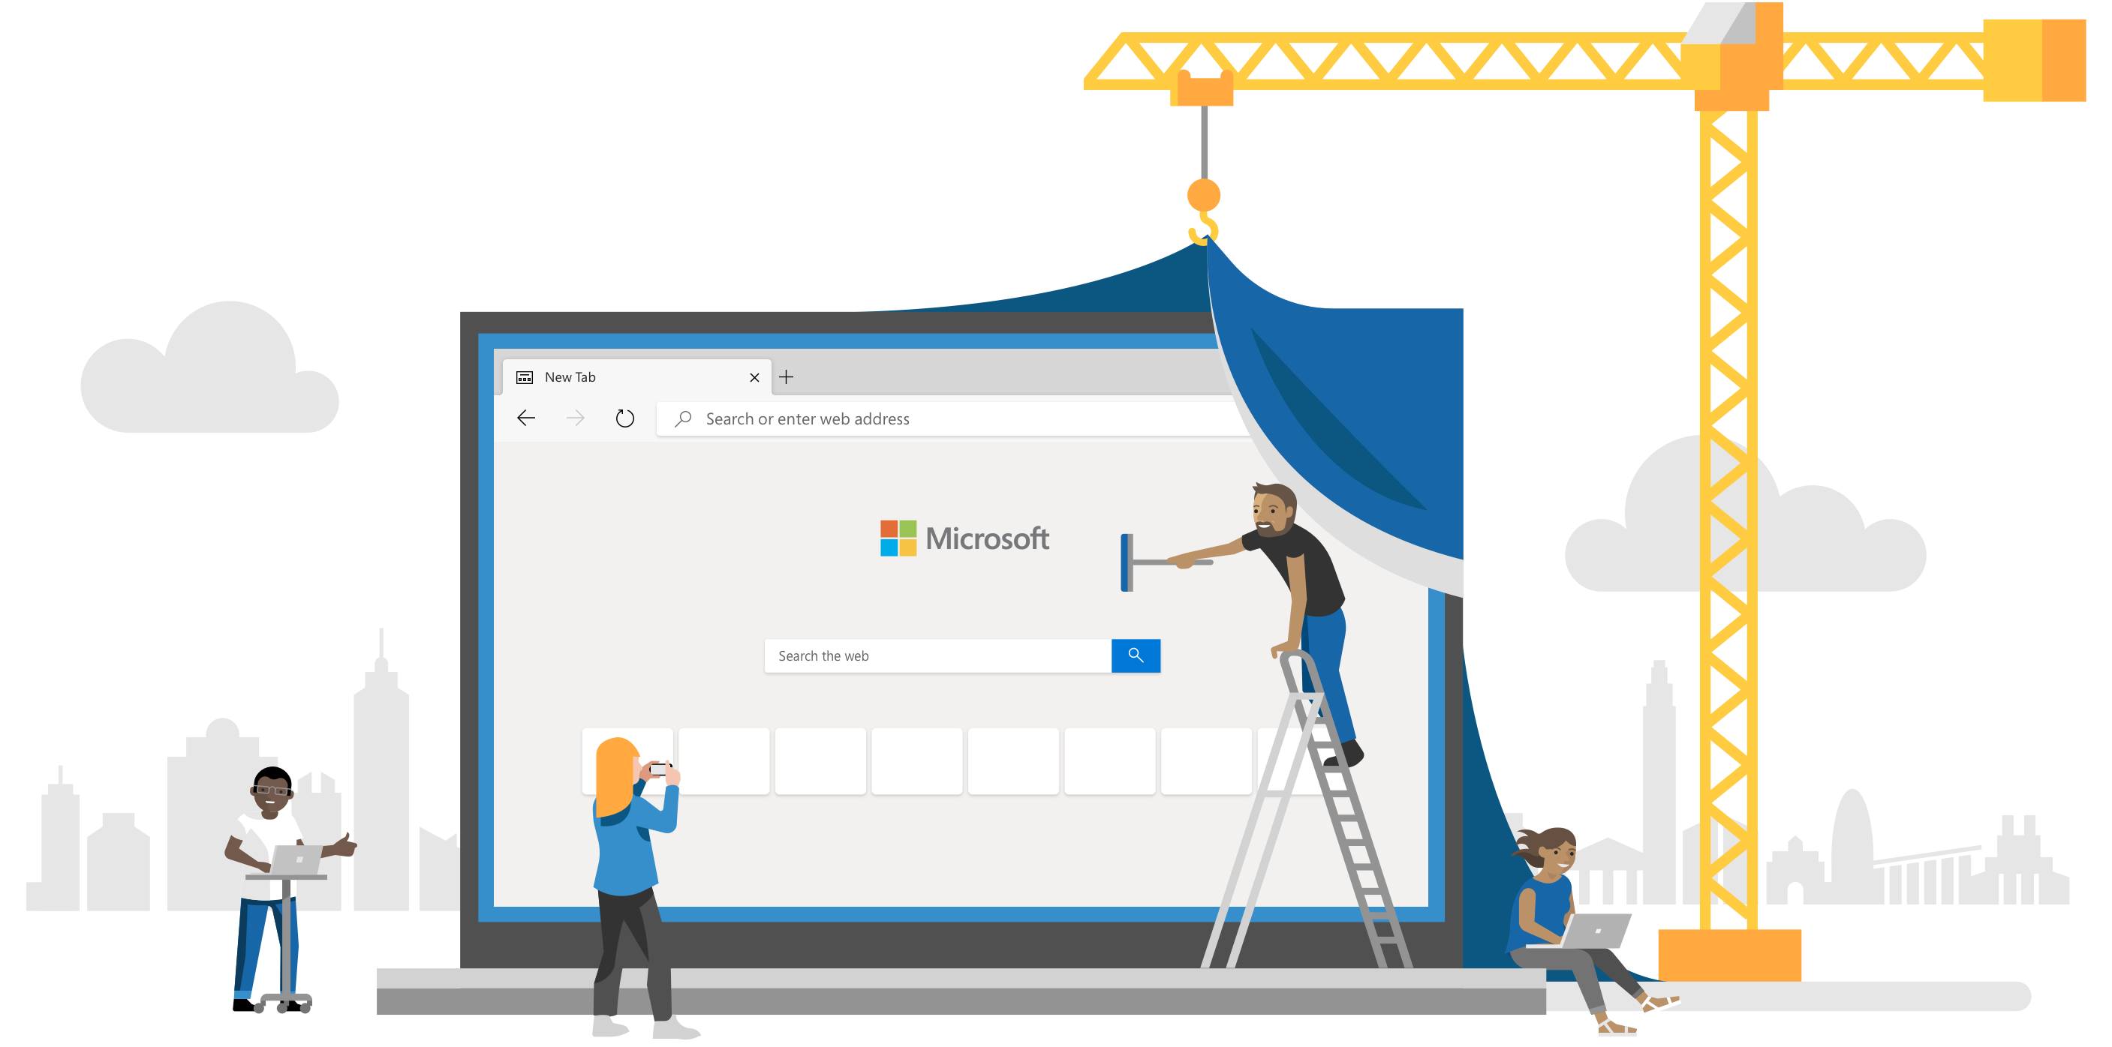
Microsoft Edge adopting Chromium
Notes:
Microsoft Edge was released Jul 29, 2015
Back in the day, I was involved with front end development, among other things, and the most frustrating thing about front end development was that you had to test software in at least 4 different browsers (and on different versions of these browsers). Worse even, Internet Explorer had a different engine than everyone else, so you had to dedicate special attention to making sure JavaScript works and HTML lines up correctly. I remember how disappointed I was to hear that Microsoft is going to roll out yet another engine, effectively adding a huge chunk of work to the front-end developer testing matrix.
In December 2018 Microsoft announced that Edge will adopt Chromium, showing that we are a different company today.
We've also started making contributions back to Chromium in areas like accessibility, touch, ARM64 and others. Our plan is to continue working in Chromium rather than creating a parallel project. We’re working directly with the teams at Google, and we're looking forward to working even more with the open source community.

Slide 44

Open Source is not a Zero-Sum Game
Notes:
By working on LibGit2 together GitHub and Microsoft BOTH benefit. As do Apple, GitLab, Atlassian and more.
By working on Chromium, battery life gets better for everyone & security improves. Arm64 on Windows support improves.

Slide 45

.NET – One small step for a software company
Source Open + Limited Contributions
Adopt Community Workflow (“true open source”)
Open Design
Notes
Improve Documentation
Source Open
Shared Ownership
Notes:
Martin

Slide 46
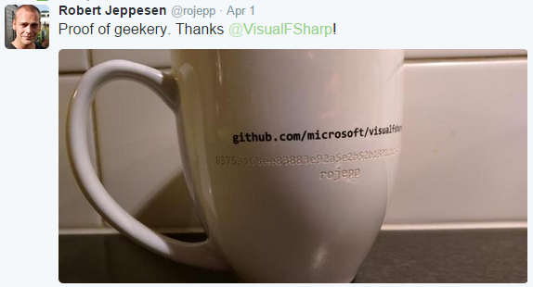
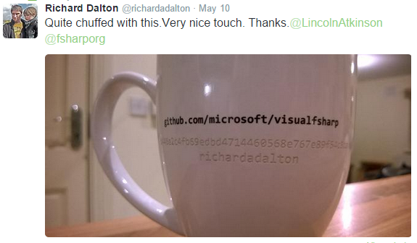

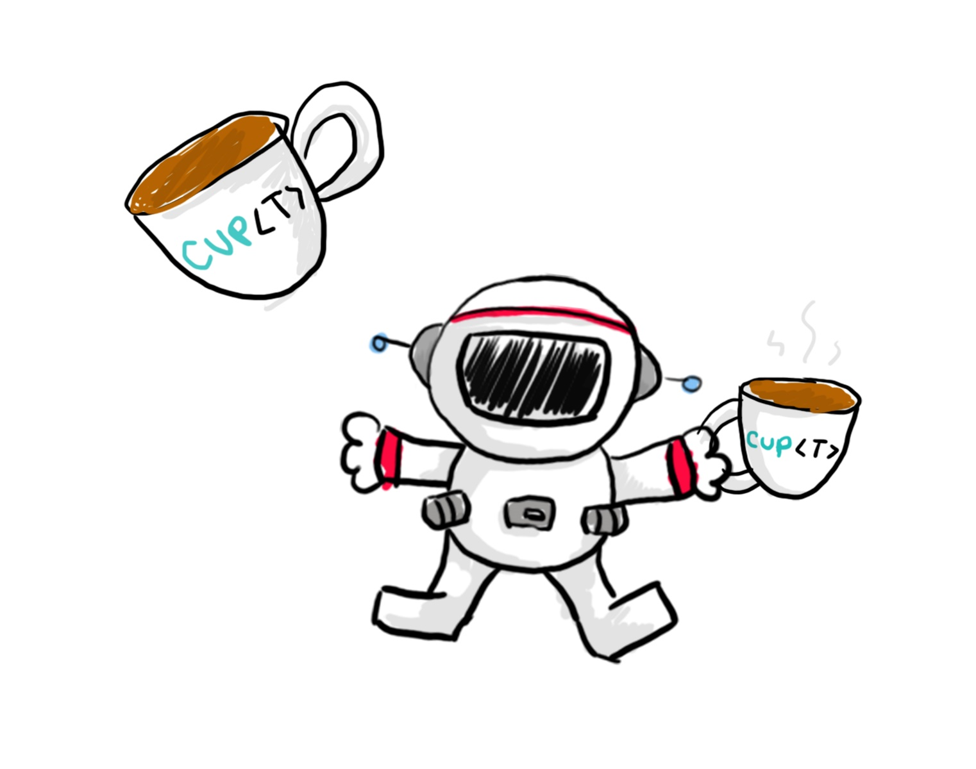
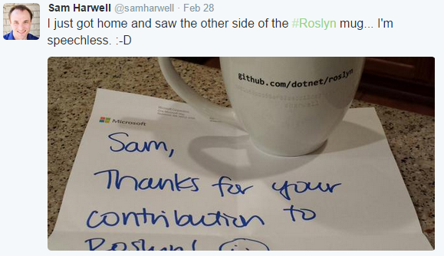
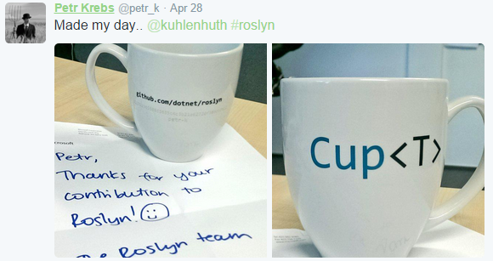
Have fun!
Notes:
Have fun! Cup campaign for Roslyn code contributors.
.NET Foundation Swag / Stickers

Slide 47

“People are initially attracted to communities for the tangible value, but the intangible value keeps them coming back for more”
- Jono Bacon
Notes:
Sasha

Slide 48
Step Five: Be the Community
Notes:
Sasha

Slide 49
Step Six: Success

Slide 50
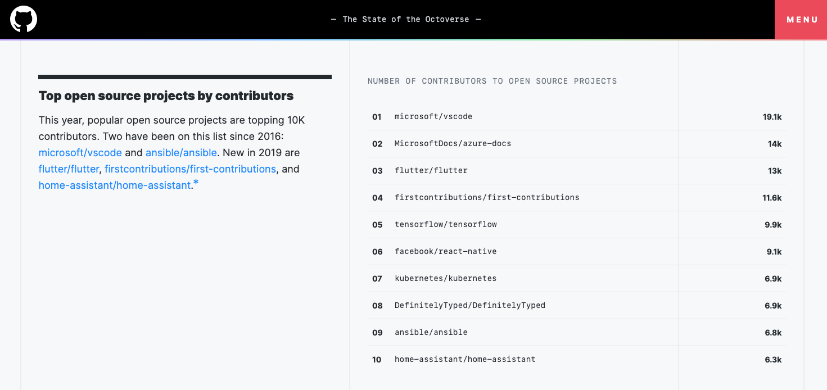

Slide 51
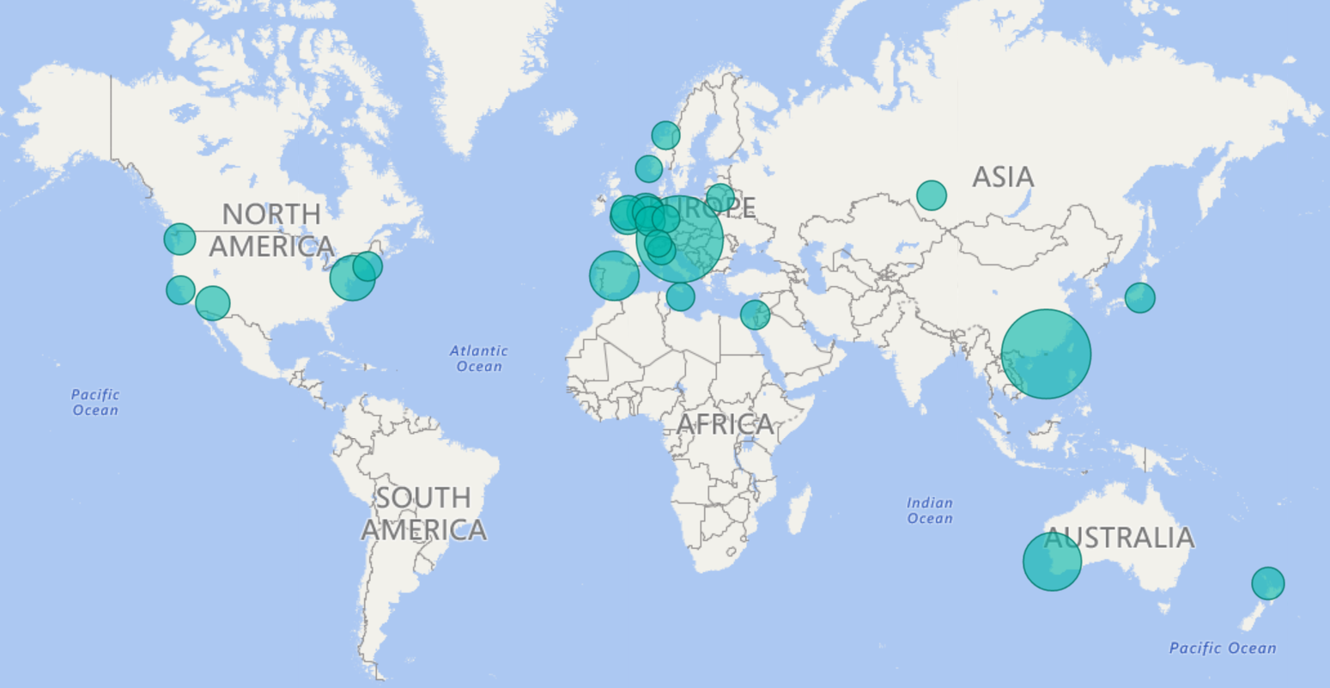
.NET in 2015

Slide 52
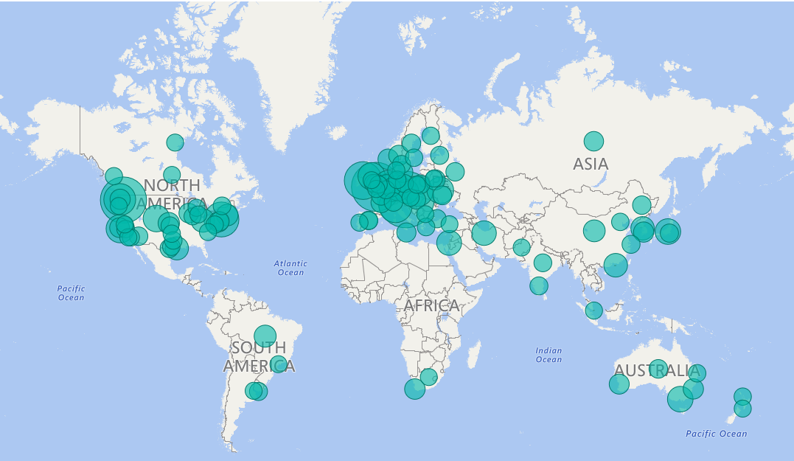
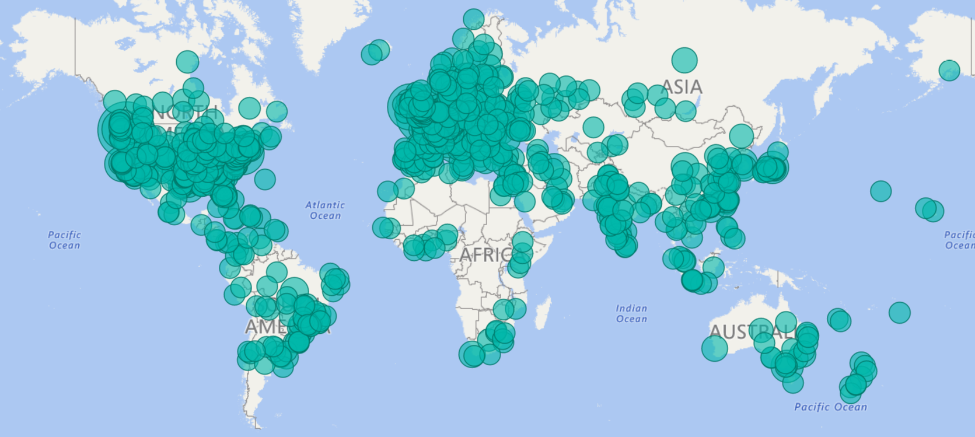
.NET in 2020

Slide 53
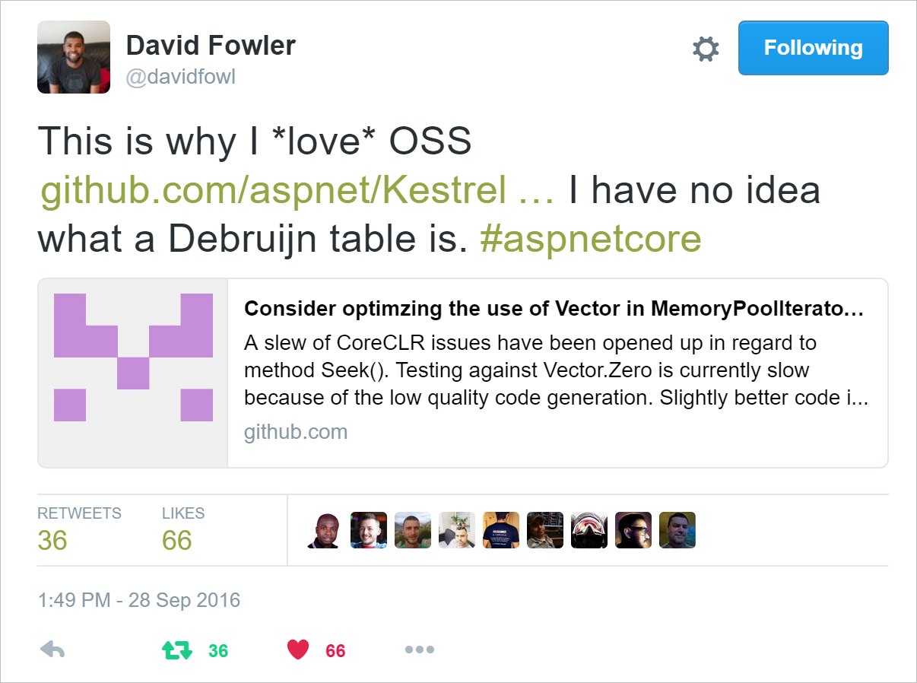
The Great Unexpected
Notes:
David Fowler Tweet

Slide 54
Step Six: Success

Slide 55
Step Seven: Inner Source
Notes:
Martin

Slide 56

InnerSource
The sharing of knowledge, skills and code inside your organization using open source style collaboration

Slide 57
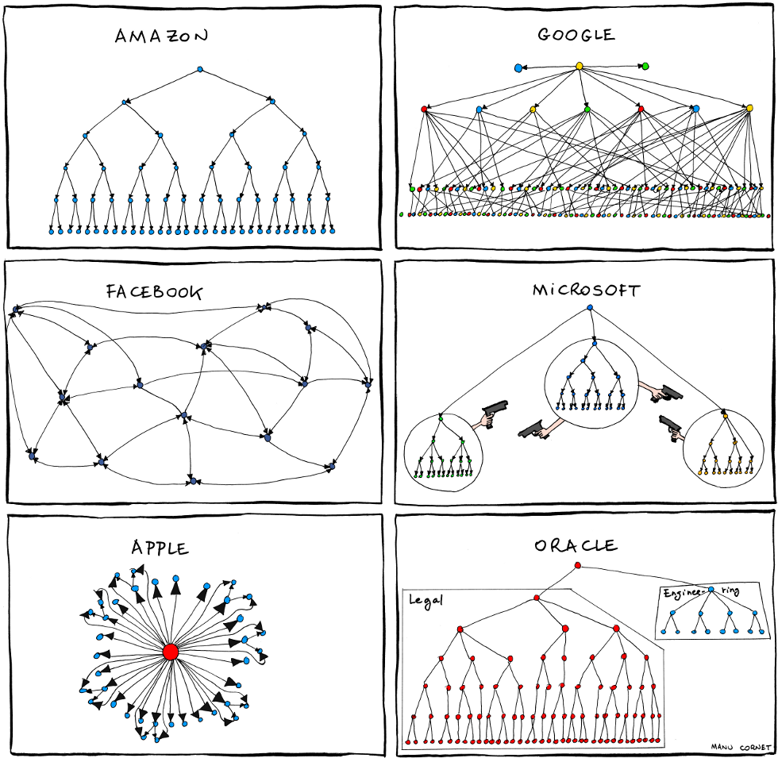
Before Inner Source
Notes:
Manu Cornet, works at Google. Org Charts from back in 2011

Slide 58
Notes:
Manu Cornet, works at Google

Slide 59
The trouble with incentives is that they work
- Leonard Sherman

Slide 60
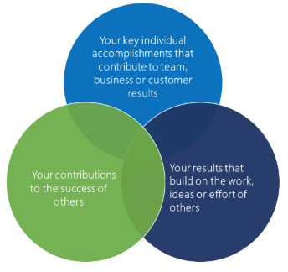
Incentives for InnerSource
Make the sharing of knowledge, skills and code inside the organization a key priority.
Encourage sharing (supply & demand)
Executive leadership vision & support
Highlight and reward sharing teams
Measuring impact

Slide 61
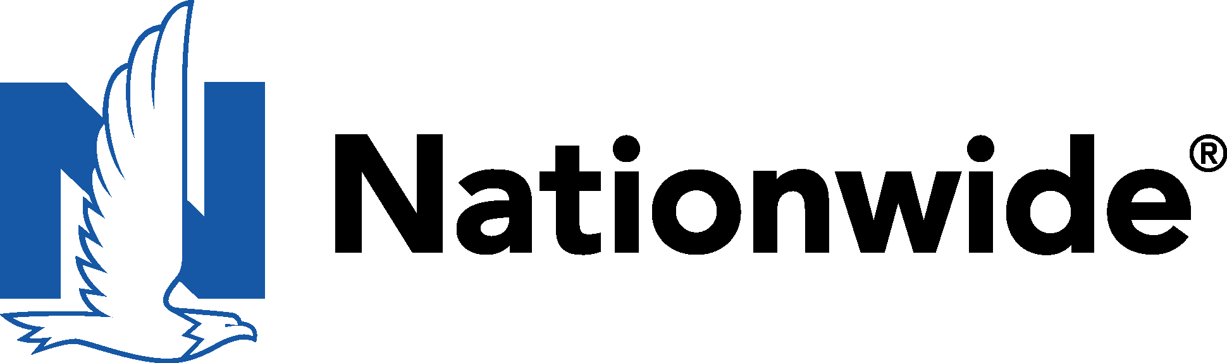


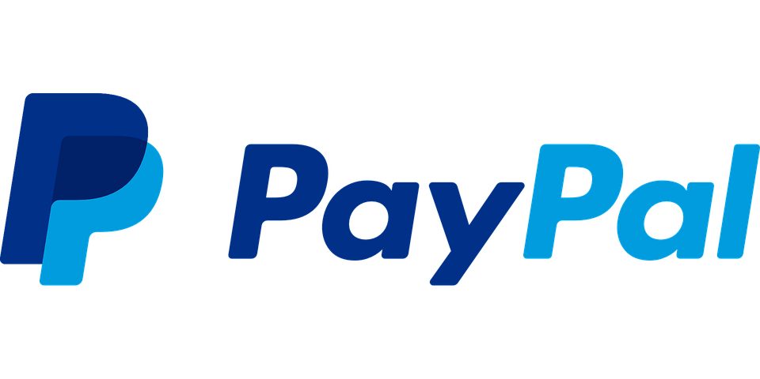



Inner source & open source in other companies
90% reduction in merge times
Faster, cheaper & better
We want you to consume OS because it’s better, but we want you to contribute to the community
Greater collaboration
Code reuse was greater than 90%. Collaboration increased 20-fold.
Rewrote Nationwide Financial 6-months ahead of schedule and 40% below budget
GitHub enabled transparency
4x increase in performance
30% increase in productivity
Giving employees greater tools to affect positive culture change
IBM teams using GitHub Enterprise to provide internal documentation - for engineering design, operations and support activities - have experienced 80% fewer escalation calls from first-line.
Notes:
Ford (****whichever example you choose) isn’t alone - here are some other examples of companies who have seen the benefits of fostering an innersource culture.
Productivity, performance, time to market and cost-savings are just a few of the benefits that can be achieved through Innersourcing.
When you are able to focus your teams on the 10-20% of differentiating code through Open Source and simultaneously increase productivity for the teams working on that focused code set through innersourcing - you are in a strong position to accelerate innovation and increase your competitive differentiation.

Slide 62


Open Source in Your Company
Step One: Consume Responsibly
Step Two: Understand the Business Need to Contribute
Step Three: Convince the Stakeholders
Step Four: Keep it Legal
Step Five: Be the Community
Step Six: Success!
Step Seven: Inner Source
Notes:
Sasha

Slide 63




Slide 65
Thank you!
Sasha Rosenbaum
@DivineOps
Martin Woodward
@martinwoodward

